Slide 1
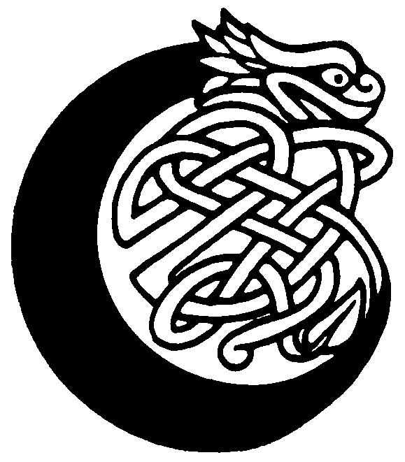
eltic knotwork
Notes:
Font: Old English Text MT

Slide 2
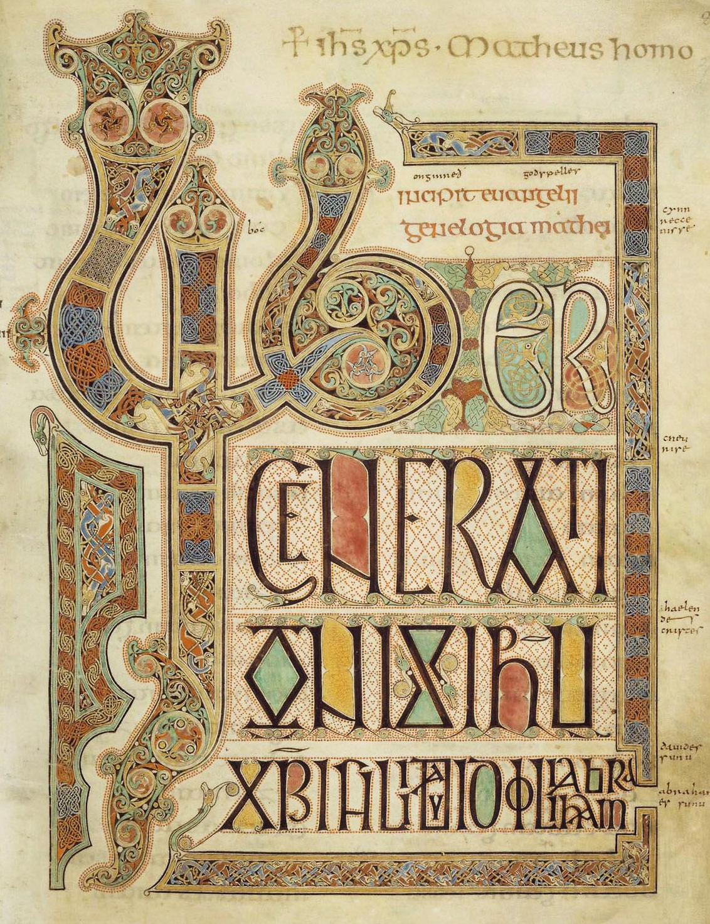
Insular animal and knot interlace, Lindisfarne Gospels, early 8th century

Slide 3
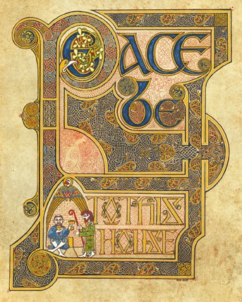
Peace be to this house, by Michael Carroll, 2005

Slide 4
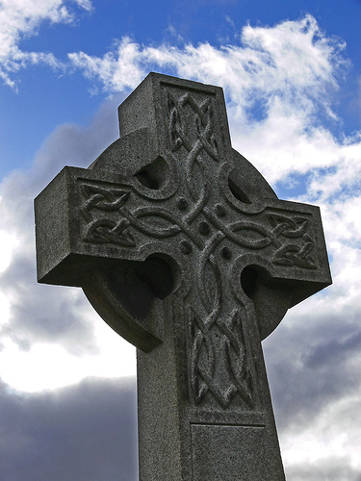
Celtic Cross at Athelstaneford; photo by Billy Kerr, 2006

Slide 5
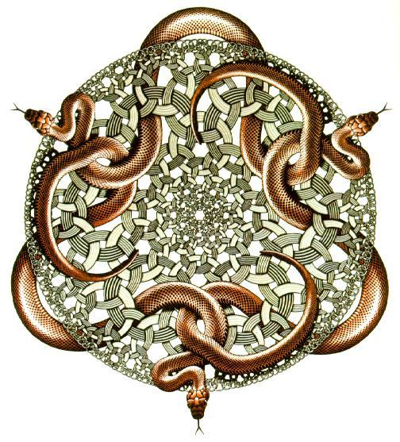
Snakes, woodcut, MC Escher, 1969

Slide 6
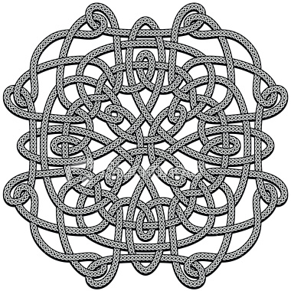

Slide 8
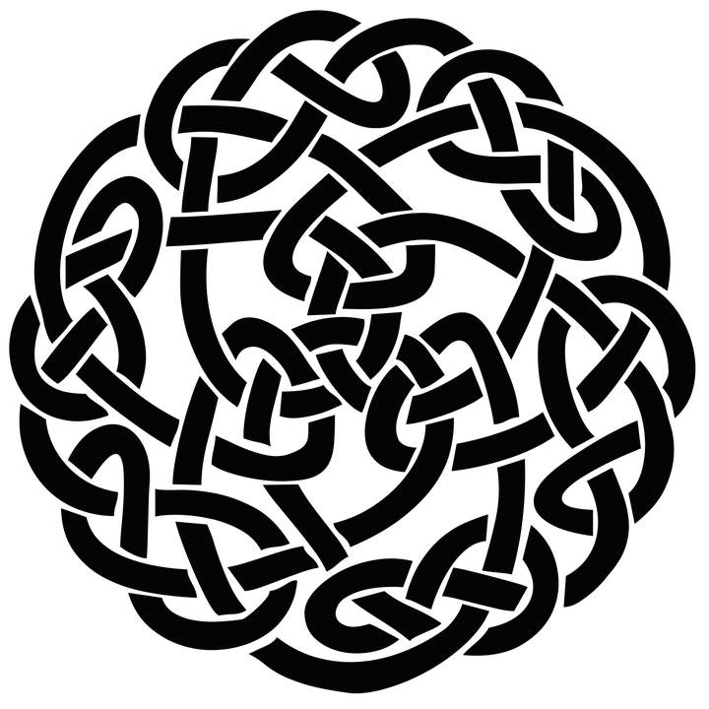

Slide 10
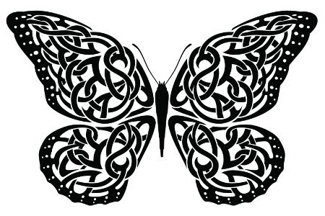

Slide 12
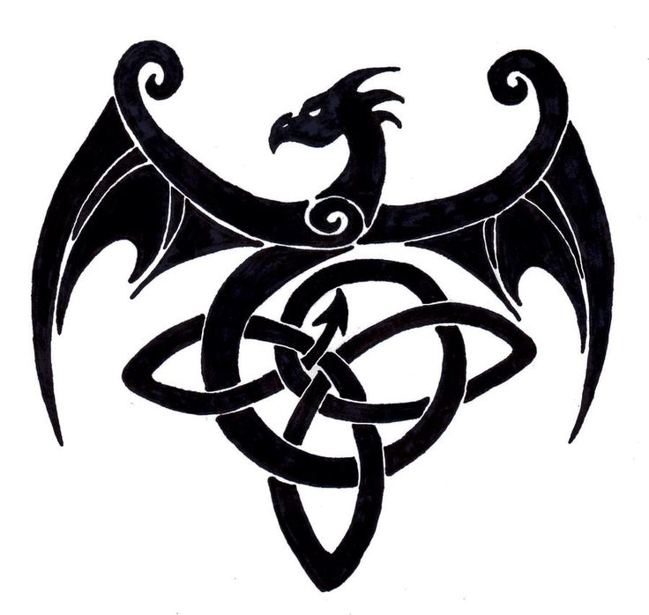

Slide 13
Step 1. Draw a grid – make sure the sides are an even number of squares.
e.g.
10
6
Step 2. Faintly mark in a border 1 square in from the edge.
Notes:
Font: Calibri

Slide 14
Step 3. Place extra dots in between the border dots.

Slide 15
Step 4. Lightly pencil in a diagonal grid using the new dots as a guide.

Slide 16
Step 5. Now lightly draw in the four arched corners...
and next the curved edges.

Slide 17
Step 6. Choose a ‘starting ribbon’ and continue it so that it goes alternately over and under the other ribbons, rubbing out as you go.
Step 7. Continue until you join up where you started.
Then choose another starting ribbon if necessary.
Finally rub out any unnecessary lines.

Slide 18
You now have a knotwork plait.

Slide 19
Step 8. Decide which crossings to rub out. Then redraw the lines so that the ribbon curves back on itself rather than along the plait.
For example: rub out an inner crossing...
or an outer crossing.

Slide 20
