Slide 1
WHO? Carl Friedrich Gauss
WHEN? 1777 - 1855
WHERE? Germany
GEEK RATING:

Slide 2
WHAT? The sum from 1 to n
$$\sum_{r=1}^{n}{r=\frac{n}{2}\left(n+1\right)}$$
and many, many other contributions to the fields of number theory, algebra, geometry and astronomy

Slide 3
FASCINATING FACT: at the age of 3 he was correcting his father’s calculations

Slide 4
WHO? Abraham de Moivre
WHEN? 1667 - 1754
WHERE? France
GEEK RATING:

Slide 5
WHAT? De Moivre’s Formula
$${\left(\cos{x}+i\sin{x}\right)}^{n}=\cos\left(nx\right)+i\sin\left(nx\right)$$
linking trigonometry with complex numbers, as well as important contributions to the fields of probability and statistics

Slide 6
FASCINATING FACT: used his knowledge about probability to earn money as a gambling consultant

Slide 7
WHO? Gottfried Leibniz
WHEN? 1646 - 1716
WHERE? Germany
GEEK RATING:

Slide 8
WHAT? The development of calculus and its notation,
e.g.$\frac{dy}{dx}=\lim_{δx→0}{\frac{δy}{δx}}$
$$F\left(x\right)=\int{f\left(x\right)dx}$$
and $\int_{a}^{b}{f\left(x\right)dx=F\left(b\right)−F\left(a\right)}$

Slide 9
FASCINATING FACT: he also developed the binary number system that underpins modern computing

Slide 10
WHO? Blaise Pascal
WHEN? 1623 - 1662
WHERE? France
GEEK RATING:

Slide 11
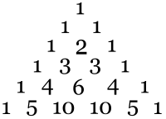
WHAT? Pascal’s Triangle, a tabular representation of the binomial coefficients
…

Slide 12
FASCINATING FACT: a prolific inventor, he made the second ever calculating machine, and also invented the syringe, the hydraulic press and the roulette wheel.

Slide 13
WHO? John Napier
WHEN? 1550 - 1617
WHERE? Scotland
GEEK RATING:

Slide 14
WHAT? Logarithms
$$y=a^{x}\overset{⇔}{}\log_{a}{y}=x$$
which were an important aid to calculation. Also popularised the use of the decimal point.

Slide 15
FASCINATING FACT: he predicted the apocalypse would occur in 1688 or 1700

Slide 16
WHO? Florence Nightingale
WHEN? 1820 - 1910
WHERE? England
GEEK RATING:

Slide 17
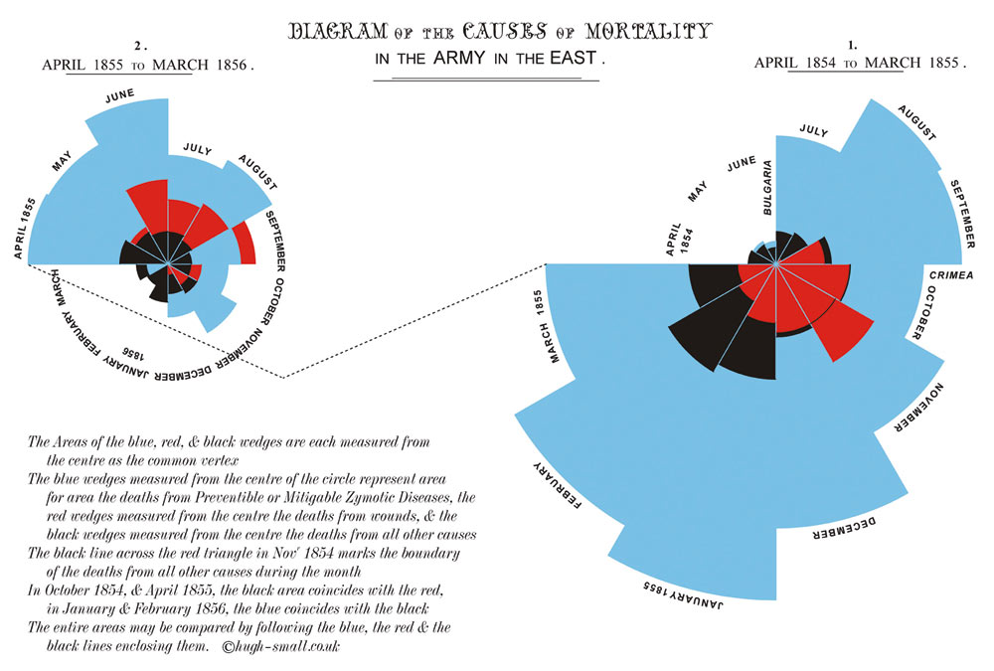
WHAT? Pioneered the visual presentation of statistical data

Slide 18
FASCINATING FACT: she was fluent in English, French, German and Italian, and knew enough to get by in Latin and classical Greek

Slide 19
WHO? Isaac Newton
WHEN? 1643 - 1727
WHERE? England
GEEK RATING:

Slide 20
WHAT? Laws of motion
an object either remains at rest or continues to move at a constant velocity, unless acted upon by a net force
$F=ma$
for every action there is an equal and opposite reaction
as well as the development of calculus at the same time as Leibniz

Slide 21
FASCINATING FACT: in 1816 his tooth was sold for £730 to an aristocrat who had it set in a ring

Slide 22
WHO? Francis Galton
WHEN? 1822 - 1911
WHERE? England
GEEK RATING:

Slide 23
WHAT? Correlation, regression and standard deviation
$$σ=\sqrt{\frac{\sum{{(x_{i}−\overline{x})}^{2}}}{n}}$$
and pioneered the use of the questionnaire

Slide 24
FASCINATING FACT: after three months of experiments, he determined a mathematical formula for the perfect cup of tea.

Slide 25
WHO? Leonhard Euler
WHEN? 1707 - 1783
WHERE? Switzerland
GEEK RATING:

Slide 26
WHAT? Much of modern mathematical notation including $f\left(x\right)$, $e$, ∑, $π$ and $i$.
Also
$$e^{iθ}=\cos{θ+i\sin{θ}}$$
$$e^{iπ}+1=0$$
$$y_{n+1}≈y_{n}+hf\left(x_{n}\right); x_{n+1}=x_{n}+h$$
and much, much more.

Slide 27
FASCINATING FACT: he was responsible for 3 out of the top 5 ‘most beautiful mathematical formulae ever’ in a 1988 poll. $e^{iπ}+1=0$ won.

Slide 28
WHO? Thomas Simpson
WHEN? 1710 - 1761
WHERE? England
GEEK RATING:

Slide 29
WHAT? Simpson’s Rule for numerical integration
$$\int_{a}^{b}{ydx≈\frac{1}{3}h\left\{\left(y_{0}+y_{n}\right)+4\left(y_{1}+y_{3}+y_{n−1}\right)+2\left(y_{2}+y_{4}+y_{n−2}\right)\right\}}$$
where $h=\frac{b−a}{n}$ and $n$ is even

Slide 30
FASCINATING FACT: dabbled in divination and caused fits in a girl after 'raising a devil‘ from her

Slide 31
WHO? Emmy Noether
WHEN? 1882 - 1935
WHERE? Germany
GEEK RATING:

Slide 32
WHAT? Noether’s theorem
and groundbreaking contributions to the field of abstract algebra and theoretical physics.

Slide 33
FASCINATING FACT: one of only two female students in a university of 986, she was required to ask the permission of those professors whose lectures she wished to attend.

