Slide 1
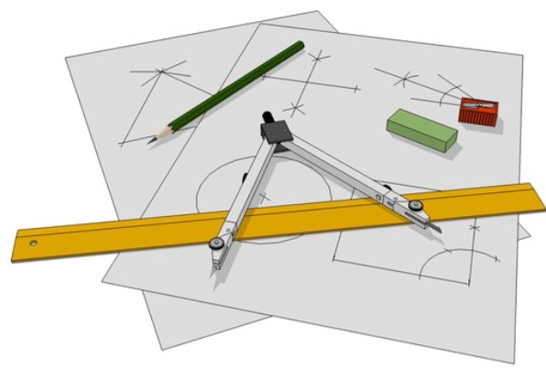
Notes:
There are printable support templates for younger students which eliminate the need for compass constructions.
Please read the teaching guidance in the notes section below certain slides.

Slide 2
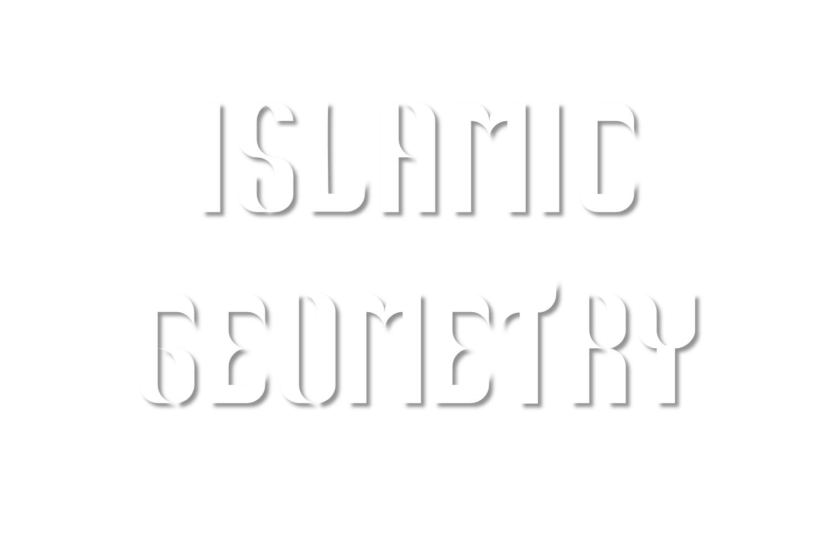
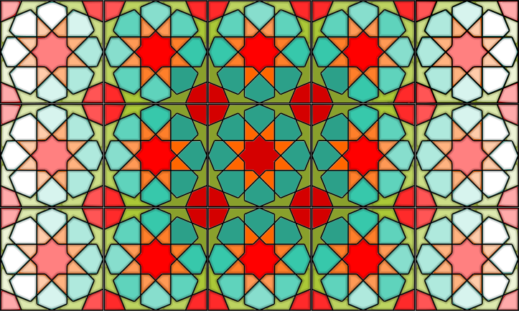
Notes:
© Artful Maths: www.artfulmaths.com Some rights reserved.

Slide 3
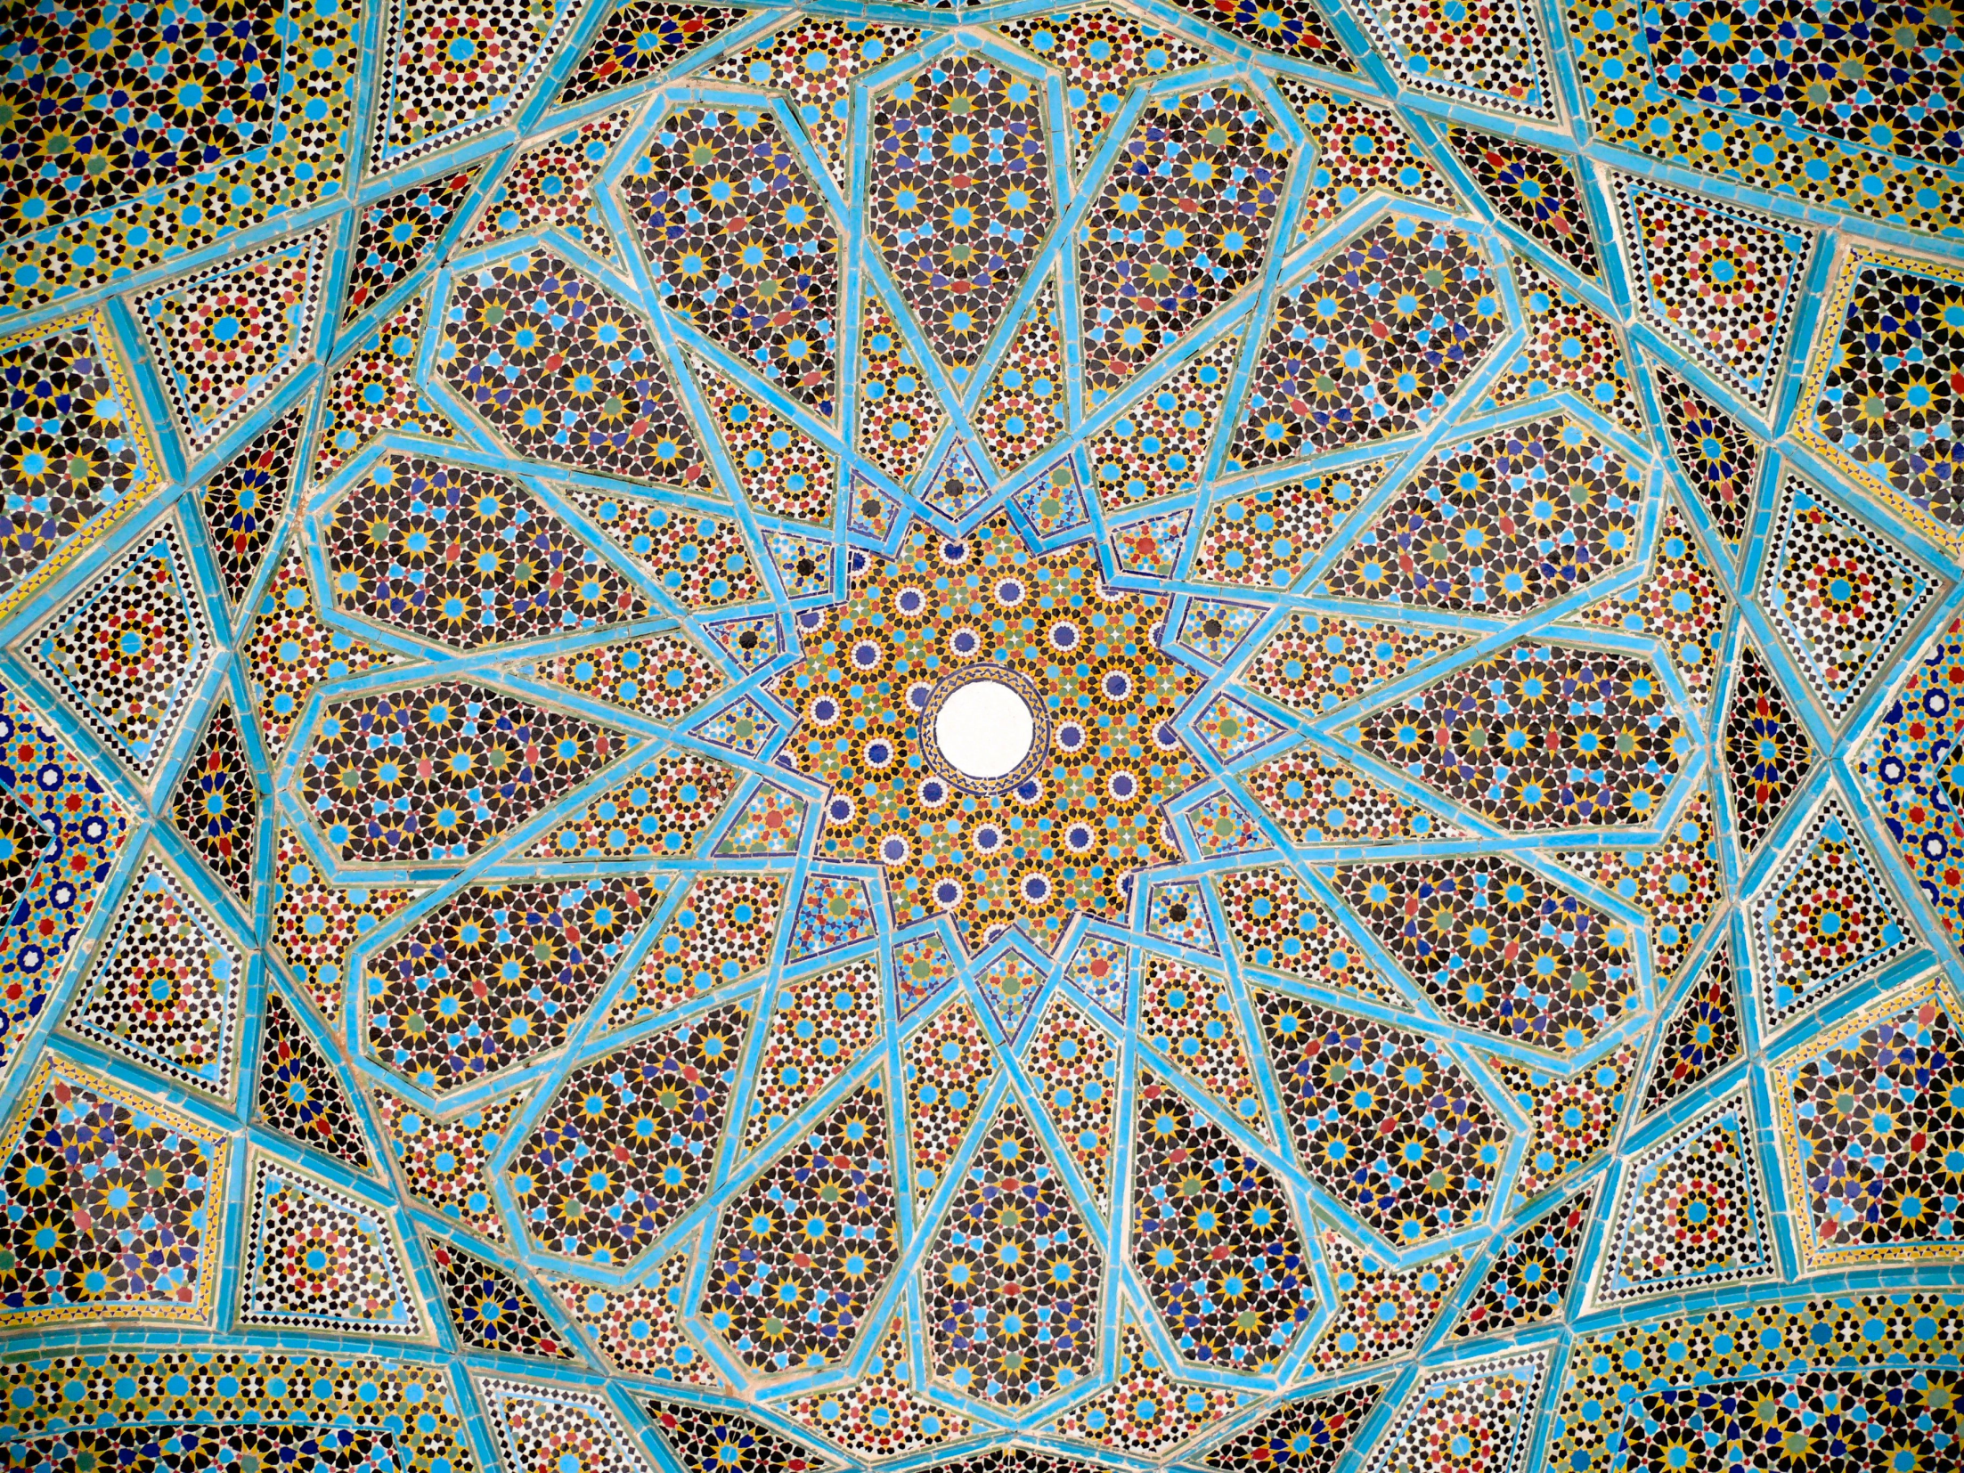
The roof of the Tomb of Hafez, Shiraz, Iran
Notes:
Source: https://en.wikipedia.org/wiki/Girih_tiles#/media/File:Roof_hafez_tomb.jpg

Slide 4
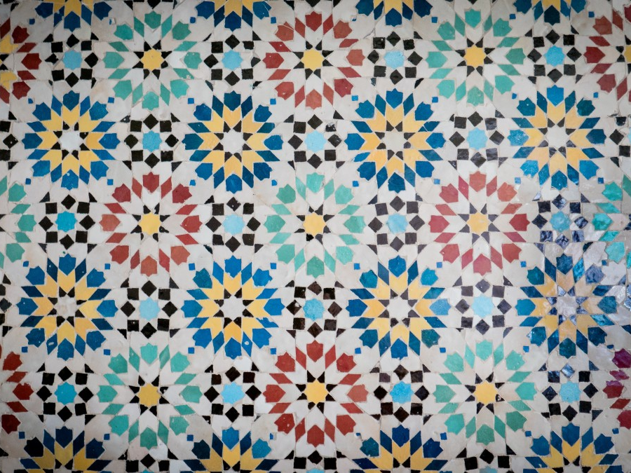
Geometric Tiling, Morocco
Notes:
Source: https://pxhere.com/en/photo/520637

Slide 5
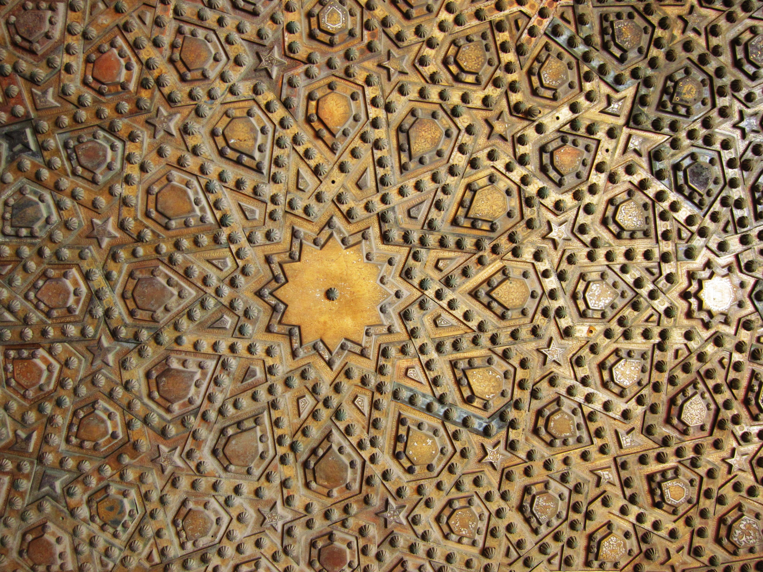
Carved gate, Sultan Hassan Mosque, Cairo, Egypt
Notes:
Source: https://commons.wikimedia.org/wiki/File:Flickr_-_HuTect_ShOts_-_Pattern_of_The_Tomb_Gate_-_Masjid_of_Sultan_Hassan_%D9%85%D8%B3%D8%AC%D8%AF_%D9%88%D9%85%D8%AF%D8%B1%D8%B3%D8%A9_%D8%A7%D9%84%D8%B3%D9%84%D8%B7%D8%A7%D9%86_%D8%AD%D8%B3%D9%86_-_Cairo_-_Egypt_-_28_05_2010.jpg

Slide 6
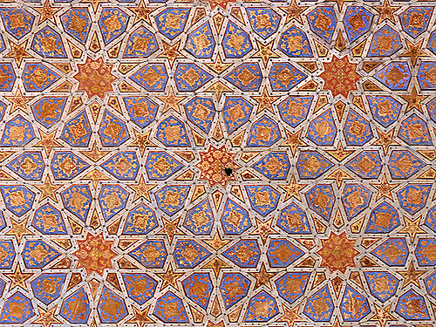
Ceiling of Chehel Sotun Palace, Isfahan, Iran
Notes:
Source: https://www.flickr.com/photos/horizon/149213037

Slide 7
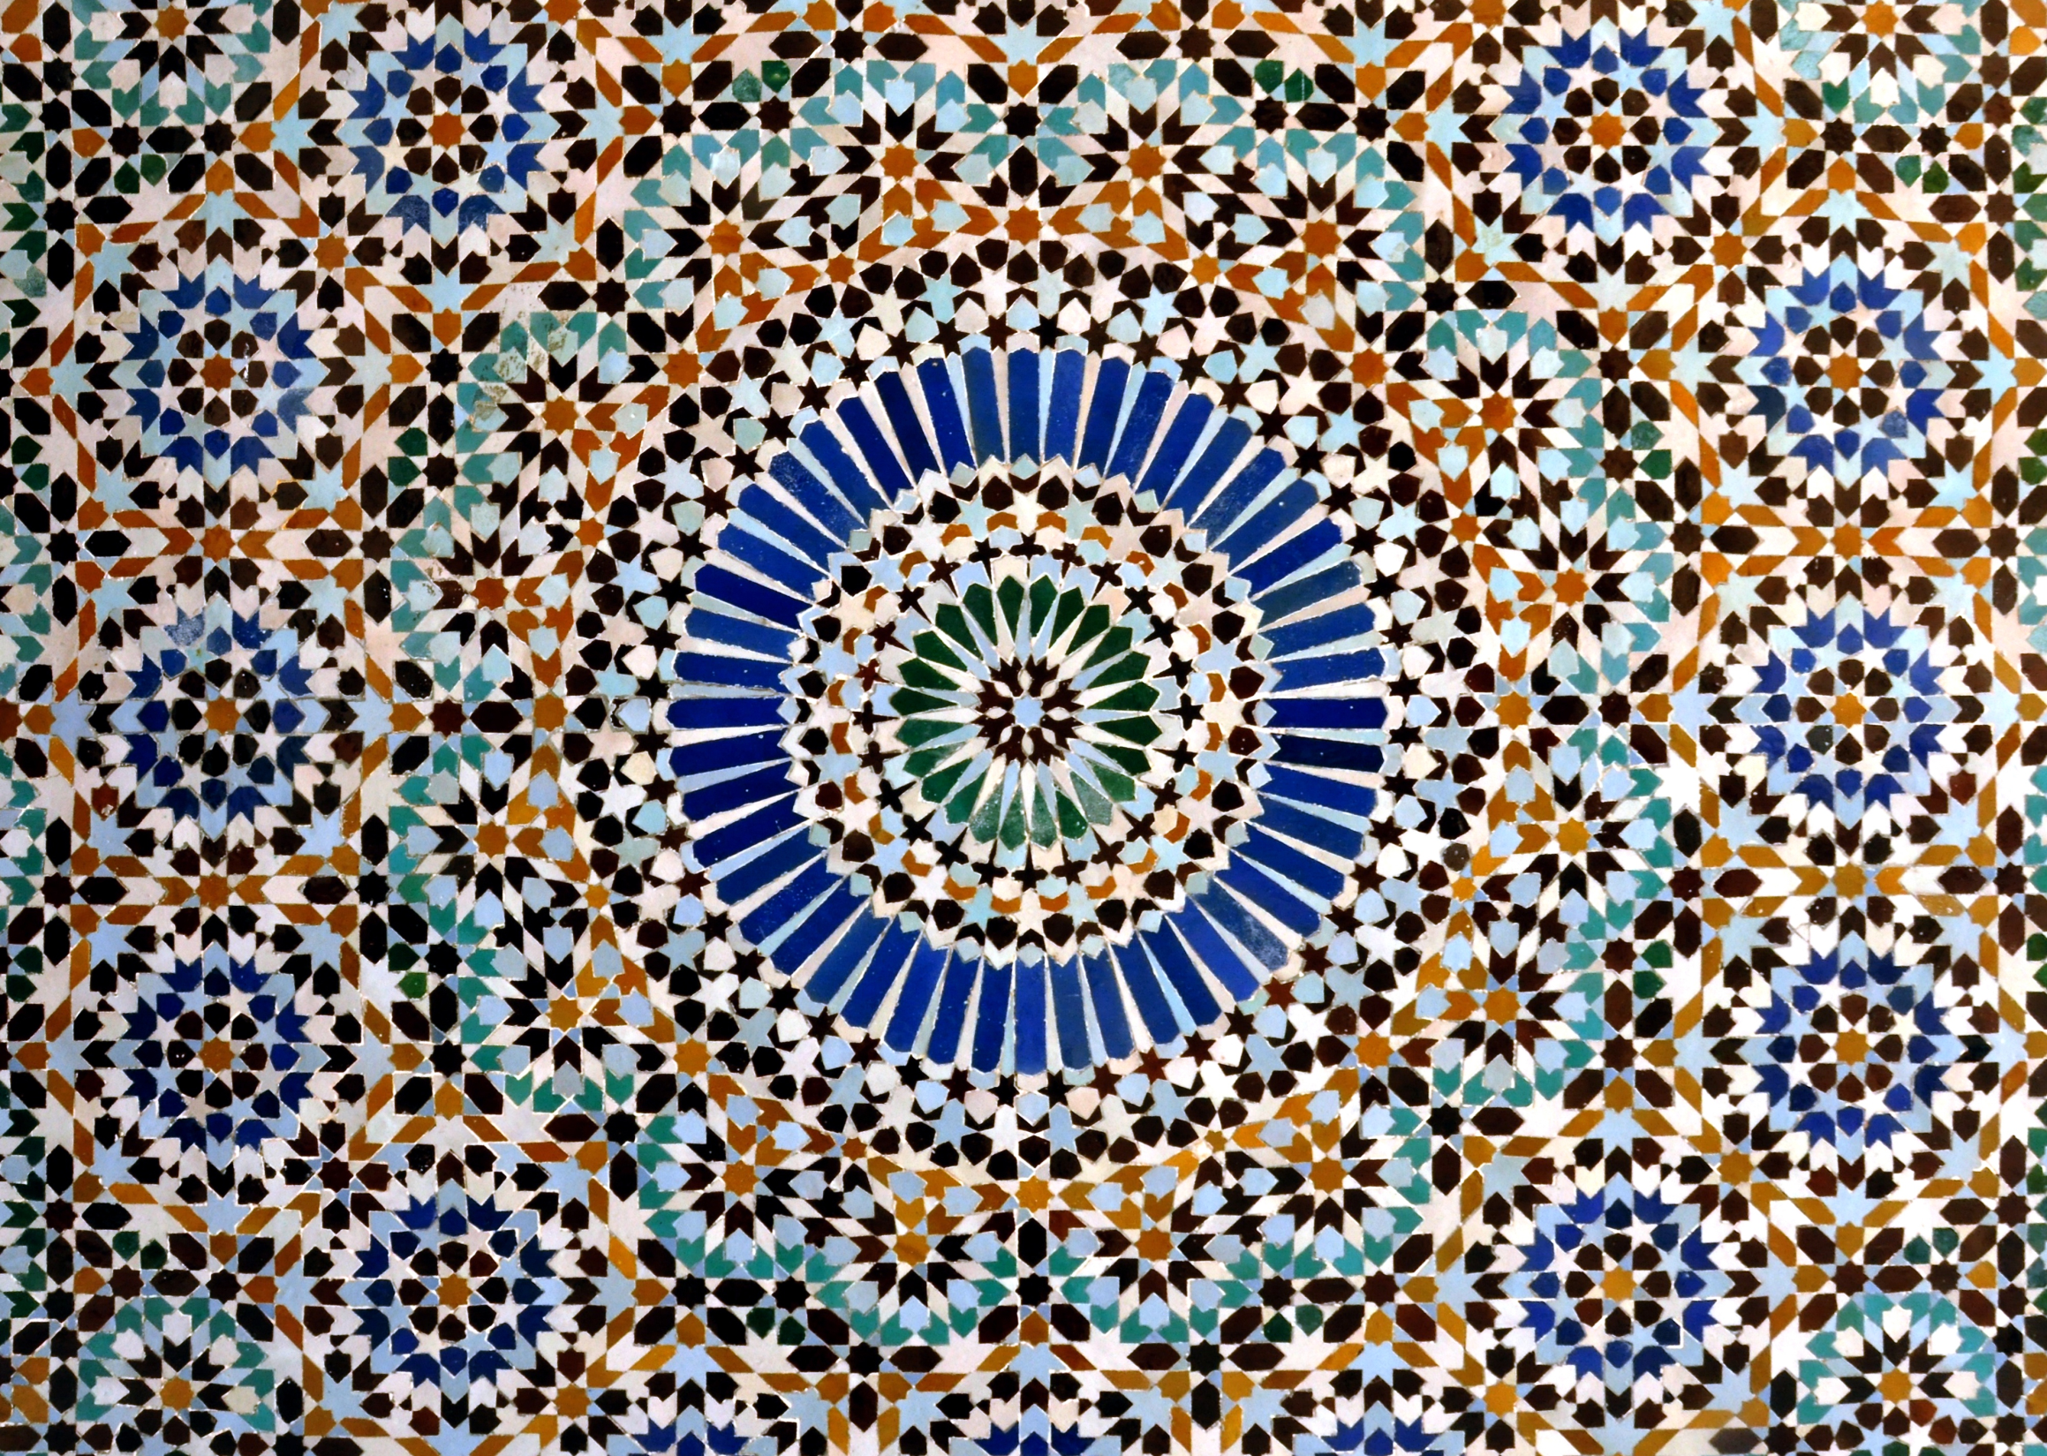
The Great Mosque of Paris, France
Notes:
Source: https://commons.wikimedia.org/wiki/File:Mosaic_-_Mosquée_de_Paris.jpg

Slide 8
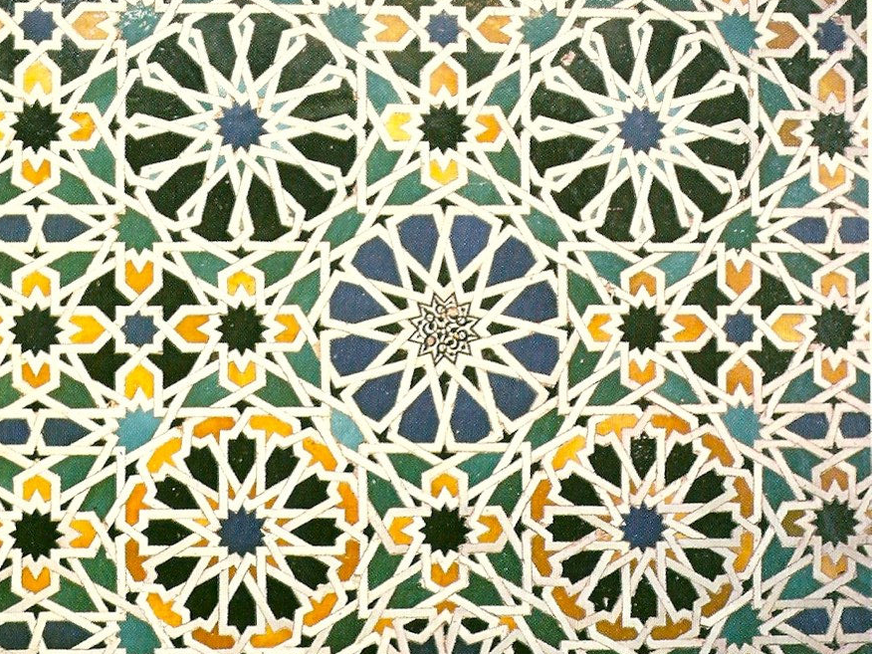
Hall of the Ambassadors, Alhambra Palace, Spain
Notes:
Source: https://www.flickr.com/photos/nat507/30019190866

Slide 9
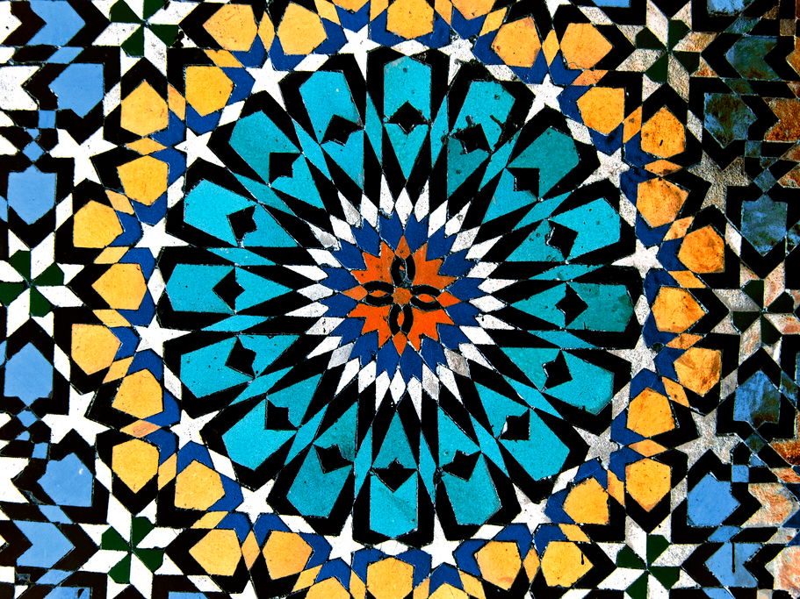
Geometric Tiles, Mosque of Moulay Idriss, Morocco
Notes:
Source: https://www.flickr.com/photos/ru_boff/14313115194

Slide 10
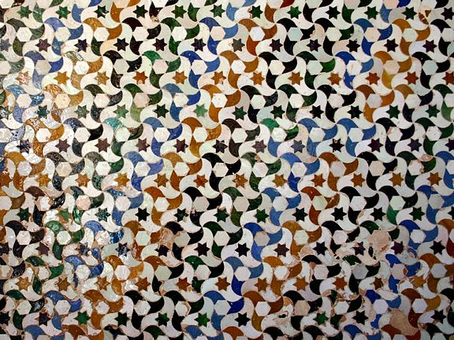
A wall in the Alhambra Palace, Granada, Spain
Notes:
Source: https://commons.wikimedia.org/wiki/File:Tassellatura_alhambra.jpg

Slide 11
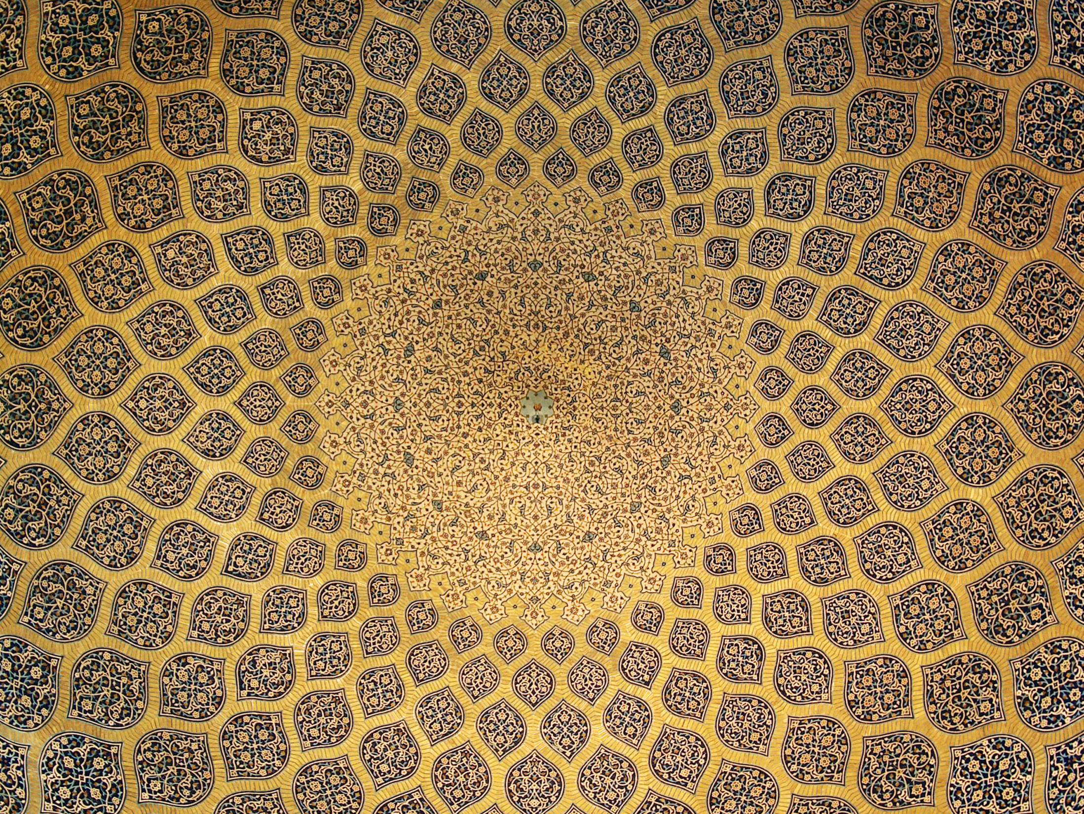
Ceiling of the Lotfollah Mosque, Isfahan, Iran
Notes:
Source: https://en.wikipedia.org/wiki/Symmetry#/media/File:Isfahan_Lotfollah_mosque_ceiling_symmetric.jpg

Slide 12
Classification system: BROUG, E. Islamic Geometric Patterns. London: Thames & Hudson, 2008
Notes:
The starting point of all Islamic Geometric designs is the circle: the symbol of unity, and the centre from which all else emerges. The starting circle is then subdivided into sectors – usually multiples of four, five or six – the number of which influence how the pattern tiles.
One way of categorising Islamic Geometric designs (Broug, 2008) is to label them according to how the pattern tiles: ‘fourfold’ patterns tessellate in squares, ‘fivefold’ patterns tessellate in pentagons (with extra bits) and ‘sixfold’ patterns tessellate in hexagons. You can tell whether a pattern exhibits fourfold, fivefold or sixfold tiling by counting the points on the stars or the ‘petals’ on the rosettes: multiples of 4 – fourfold, multiples of 5 – fivefold, multiples of 6 – sixfold. Common multiples of 4 and 6 (e.g. 12) can be found tiling as either fourfold or sixfold patterns.
The next three slides demonstrate this idea.

Slide 13
Notes:
Source: https://pxhere.com/en/photo/520637
Count the ‘petals’: 8, therefore it’s a fourfold pattern and tessellates in squares

Slide 14
Notes:
Source: https://www.flickr.com/photos/horizon/149213037
Count the ‘petals’: 10, therefore it’s a fivefold pattern and tessellates in pentagons (with extra bits)

Slide 15
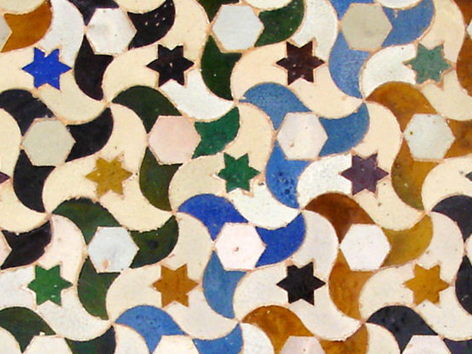
Notes:
Source: https://commons.wikimedia.org/wiki/File:Tassellatura_alhambra.jpg
Count the points on the star: 6, therefore it’s a sixfold pattern and tessellates in hexagons

Slide 16
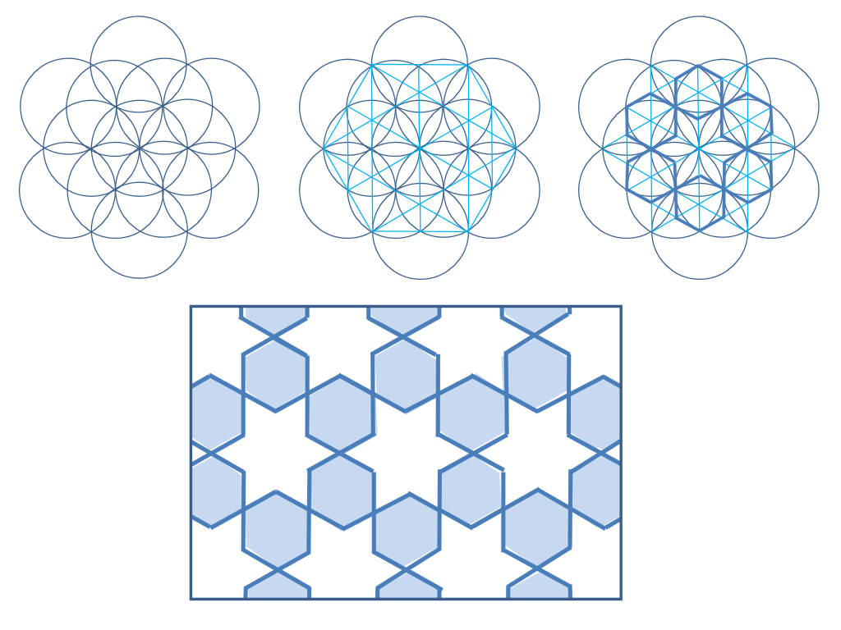
Notes:
Source: https://commons.wikimedia.org/wiki/File:Girih_compass_straightedge_example.svg
All Islamic geometric designs start with a grid of circles. This is a ‘7-grid’: at the centre is one circle surrounded by six others (this will create a sixfold pattern tessellating in hexagons).
Next the ‘underlying grid’ is created by drawing straight lines through specific points made by the intersections of the circles.
Finally sections of the underlying grid are picked out to form the final design. The underlying grid is no longer visible but its geometries influence the final design. Some artists prefer to leave the underlying grid visible in sections, or towards the edges of their paintings.

Slide 17
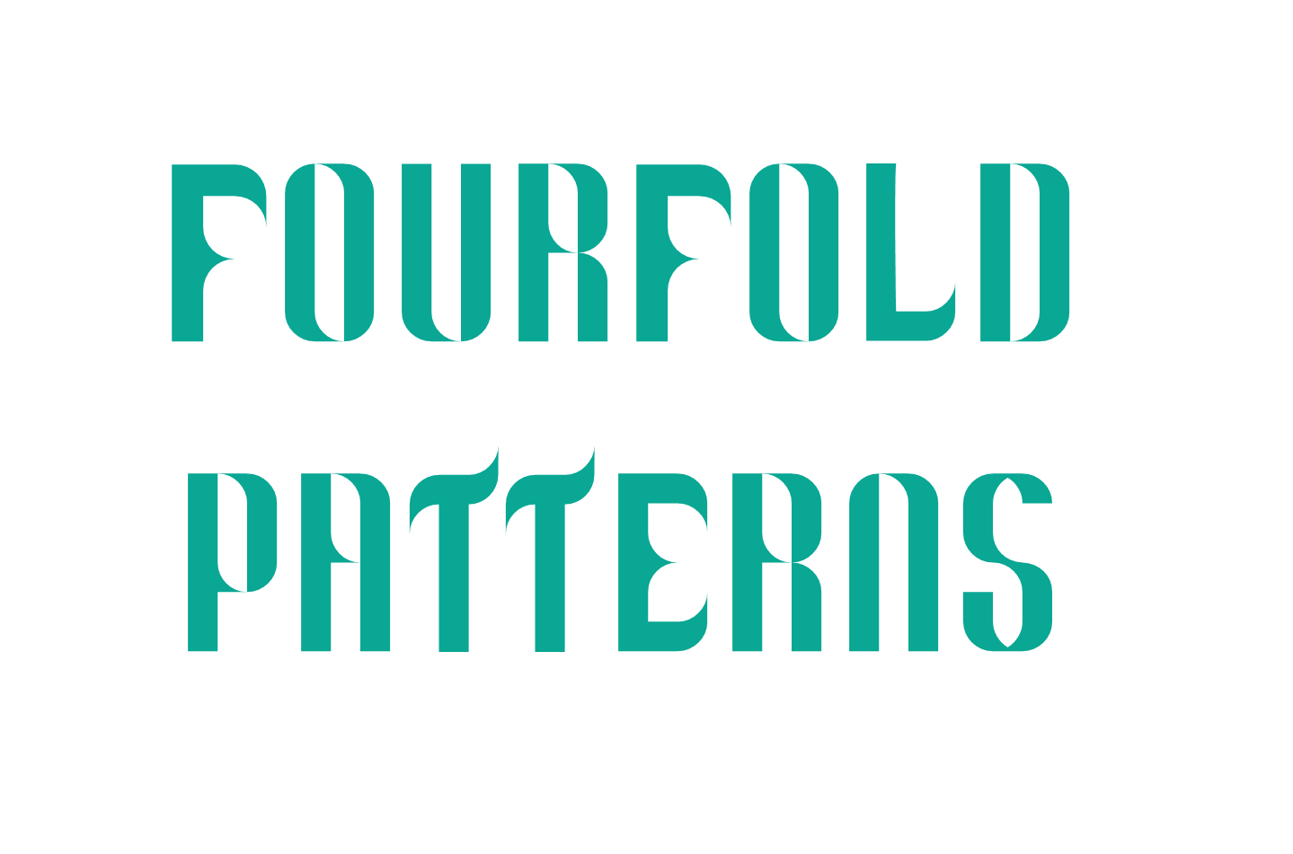
Notes:
This presentation contains instructions for three different fourfold patterns, all starting from a ‘5-grid’ – one central circle surrounded by four others. Instructions for the compass and straightedge construction of the grid are on the next slide, or students can use the ‘inscribed circle template’ provided.

Slide 18
Notes:
The construction of the 5-grid or inscribed circle (alternatively, use the template provided).

Slide 19
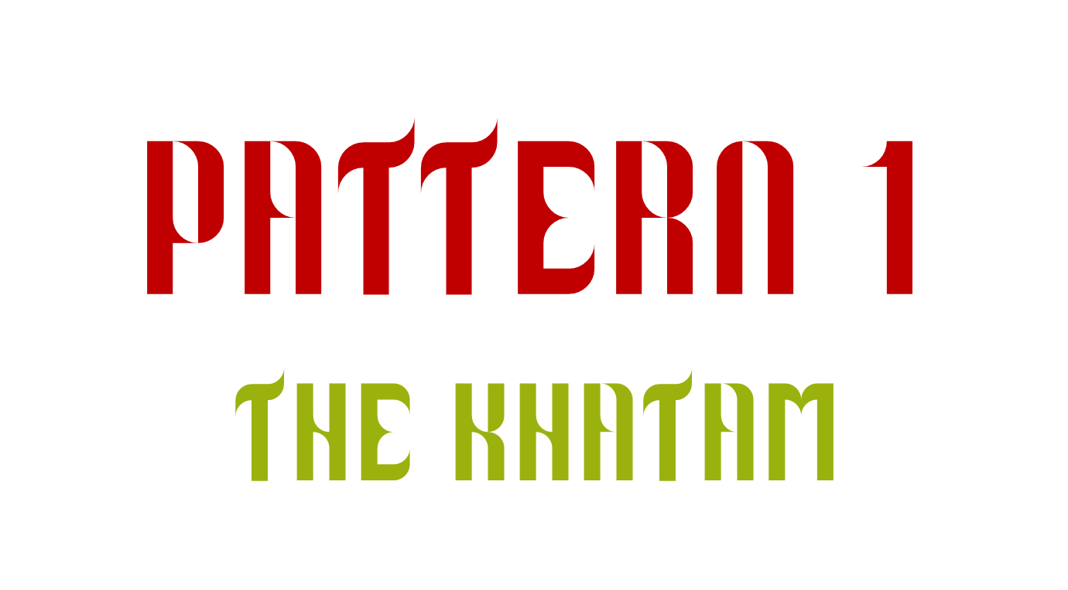

Slide 20
Notes:
Creating the underlying grid – this stage should be undertaken in pencil.

Slide 21
Notes:
Creating the underlying grid – this stage should be undertaken in pencil.

Slide 22
Notes:
Picking out the overlying pattern – this stage should be undertaken in a different colour, or with pen.

Slide 23
Notes:
Picking out the overlying pattern – this stage should be undertaken in a different colour, or with pen.

Slide 24
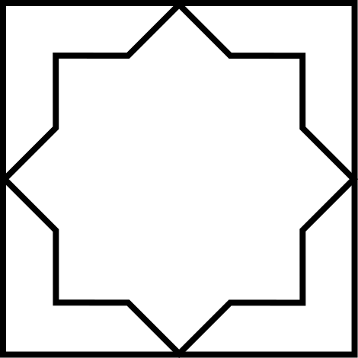
Notes:
The final pattern!

Slide 25
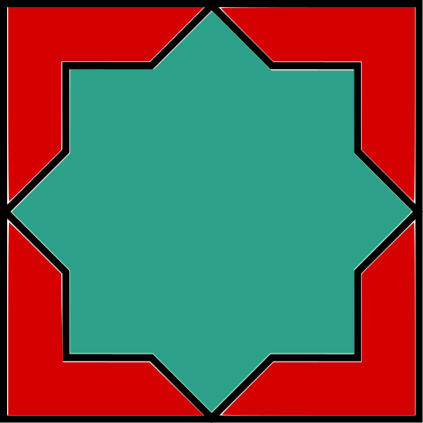
Notes:
Ask students to predict what will happen when the designs tessellate: what new shapes will emerge?
Students can cut out and colour in their designs. They will look fantastic tessellated together in a display.
If students wish they can also make their own 3 x 3 design. Instructions for constructing the 3 x 3 grid are at the end of the presentation, or students can use the template provided.

Slide 27
Notes:
Creating the underlying grid – this stage should be undertaken in pencil.

Slide 28
Notes:
Creating the underlying grid – this stage should be undertaken in pencil.

Slide 29
Notes:
Creating the underlying grid – this stage should be undertaken in pencil.

Slide 30
Notes:
Picking out the overlying pattern – this stage should be undertaken in a different colour, or with pen.

Slide 31
Notes:
Picking out the overlying pattern – this stage should be undertaken in a different colour, or with pen.

Slide 32
Notes:
Picking out the overlying pattern – this stage should be undertaken in a different colour, or with pen.

Slide 33
Notes:
The final pattern!

Slide 34
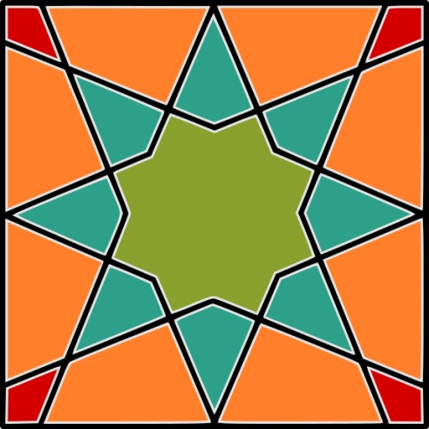
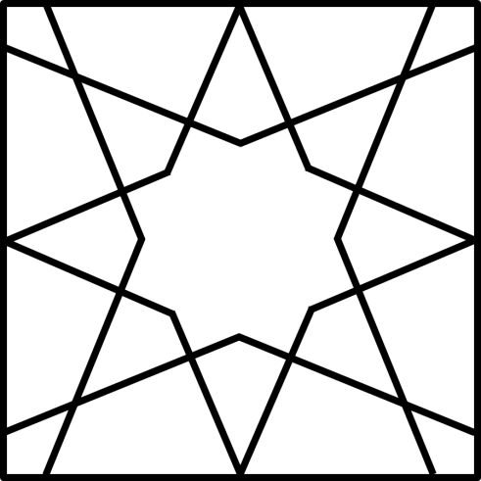
Notes:
Ask students to predict what will happen when the designs tessellate: what new shapes will emerge?
Students can cut out and colour in their designs. They will look fantastic tessellated together in a display.
If students wish they can also make their own 3 x 3 design. Instructions for constructing the 3 x 3 grid are at the end of the presentation, or students can use the template provided.

Slide 35
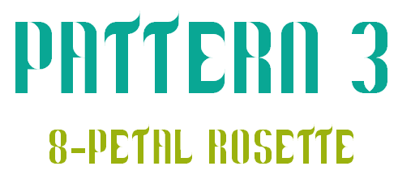

Slide 36
Notes:
Creating the underlying grid – this stage should be undertaken in pencil.

Slide 37
Notes:
Creating the underlying grid – this stage should be undertaken in pencil.

Slide 38
Notes:
Creating the underlying grid – this stage should be undertaken in pencil.

Slide 39
Notes:
Creating the underlying grid – this stage should be undertaken in pencil.

Slide 40
Notes:
Creating the underlying grid – this stage should be undertaken in pencil.

Slide 41
Notes:
Picking out the overlying pattern – this stage should be undertaken in a different colour, or with pen.

Slide 42
Notes:
Picking out the overlying pattern – this stage should be undertaken in a different colour, or with pen.

Slide 43
Notes:
Picking out the overlying pattern – this stage should be undertaken in a different colour, or with pen.

Slide 44
Notes:
Picking out the overlying pattern – this stage should be undertaken in a different colour, or with pen.

Slide 45
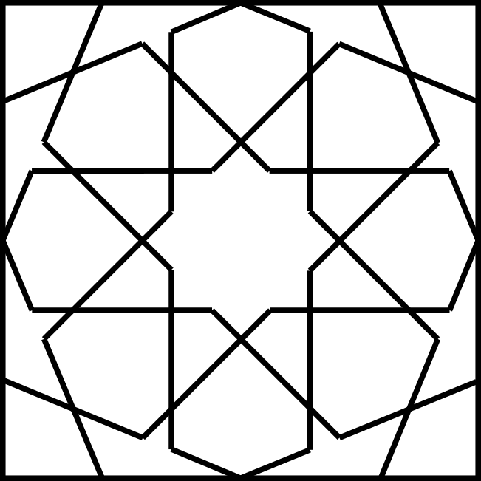
Notes:
The final pattern!

Slide 46
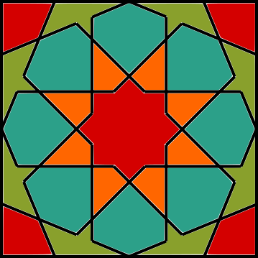
Notes:
Ask students to predict what will happen when the designs tessellate: what new shapes will emerge?
Students can cut out and colour in their designs. They will look fantastic tessellated together in a display.
If students wish they can also make their own 3 x 3 design. Instructions for constructing the 3 x 3 grid are at the end of the presentation, or students can use the template provided.

Slide 47
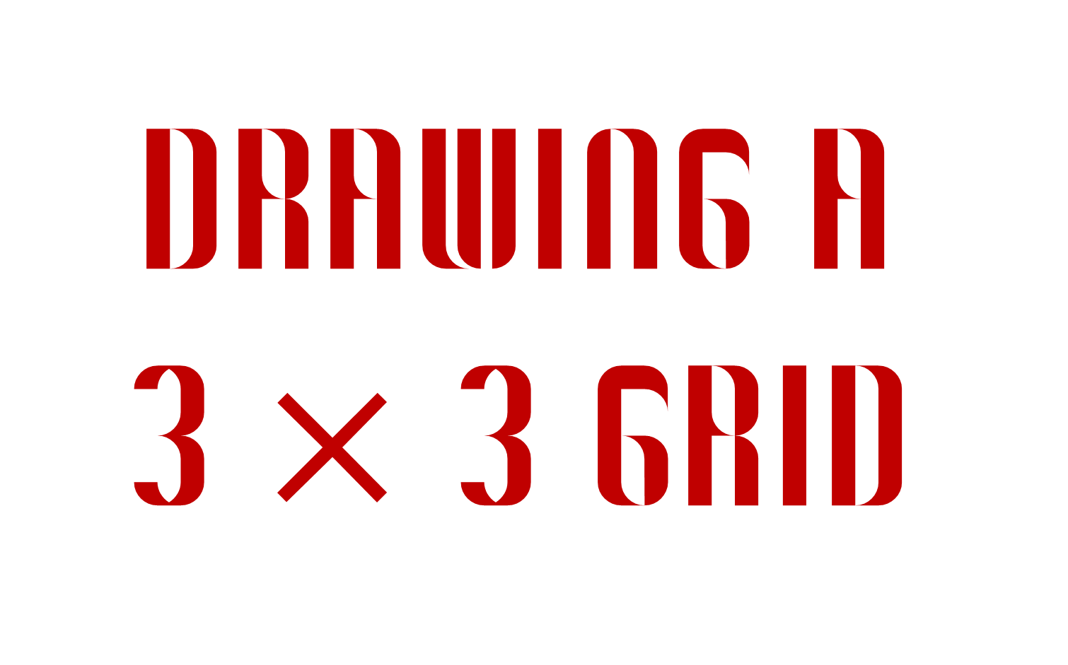

Slide 48
Notes:
The construction of a 3 x 3 grid of inscribed circles (or use the ‘inscribed circle grid template’ provided).

Slide 49
Notes:
The construction of a 3 x 3 grid of inscribed circles (or use the ‘inscribed circle grid template’ provided).

Slide 50
Notes:
The construction of a 3 x 3 grid of inscribed circles (or use the ‘inscribed circle grid template’ provided).

Slide 51
Joumana Medlej’s excellent set of free tutorials:
https://design.tutsplus.com/series/geometric-design-for-beginners--cms-790
Samira Mian’s beautiful website and Youtube tutorials:
www.samiramian.uk
https://www.youtube.com/playlist?list=PLHG5uxhiqH9WAEElqs6BzuTVLyCKEboSR
The Metropolitan Museum’s Islamic Art teaching resource:
https://www.metmuseum.org/-/media/Files/Learn/For%20Educators/Publications%20for%20Educators/Islamic_Art_and_Geometric_Design.pdf
Eric Broug’s website, Ted-Ed video and books:
http://www.sigd.org/
https://youtu.be/pg1NpMmPv48
https://www.amazon.co.uk/Eric-Broug/e/B00279HMU8/ref=sr_tc_2_0?qid=1529828666&sr=8-2-ent
Islamic art photo archive:
https://patterninislamicart.com/
Short video showing the process of process of producing Moroccan tiles – fascinating!:
https://www.youtube.com/watch?v=t-n03ano-Ak

