Slide 1
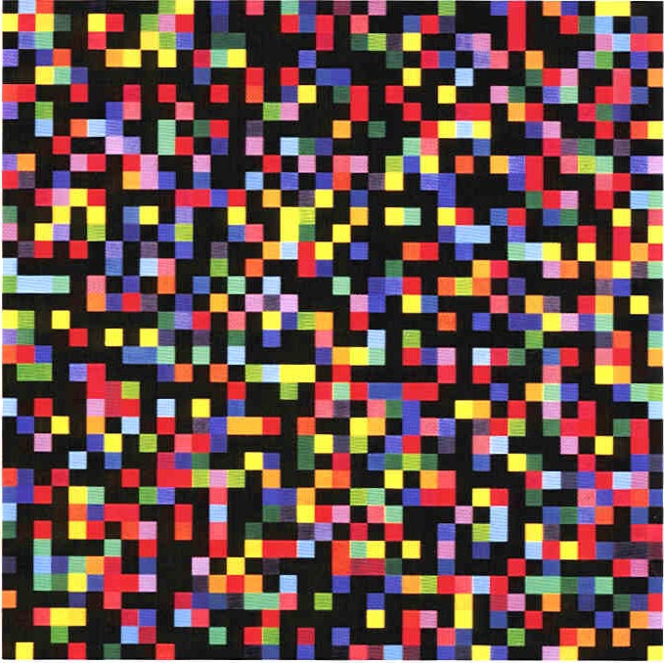
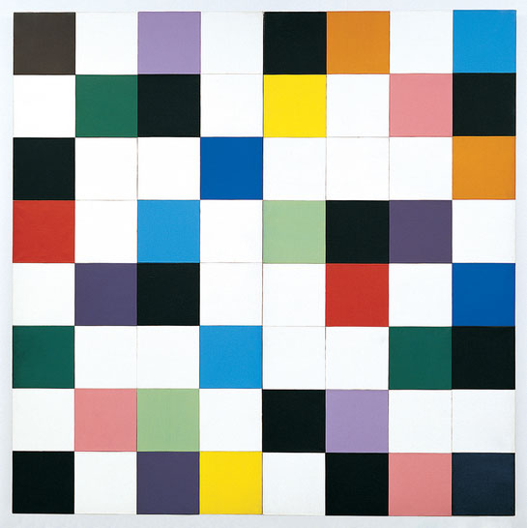
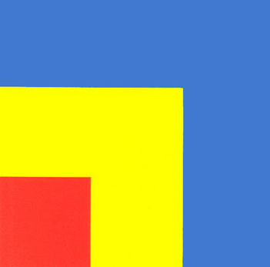
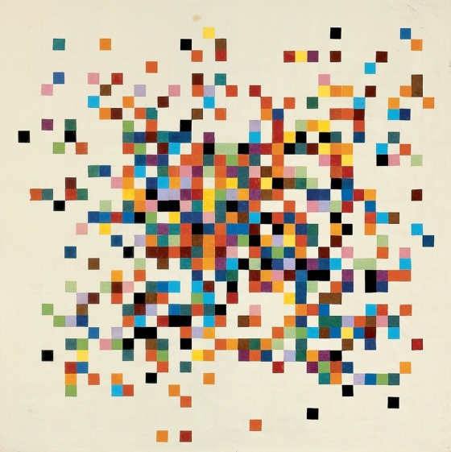
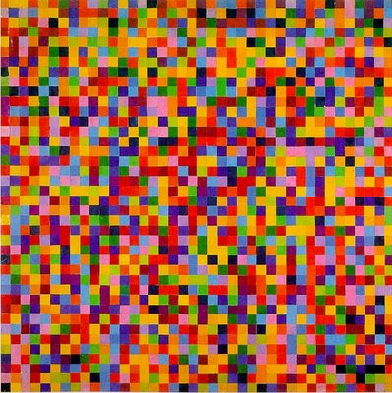
Modern Art Maths
Paintings by Ellsworth Kelly
Notes:
Fonts: Kristen ITC and Garamond
The paintings are titled as follows (from left to right):
Spectrum Colors Arranged by Chance VI
Colors for a Large Wall
Spectrum I
Red Yellow Blue
Spectrum Colors Arranged by Chance III
Spectrum Colors Arranged by Chance VII

Slide 2
You will be given some squares on different coloured paper
Think about your design and cut out the squares you need
Place your coloured squares onto the 100 square grid to create your modern art piece.
When you are happy with your finished product stick down the squares, then fill in the table underneath.
Can you work out the equivalent fractions, decimals and percentages for each colour?

